Slide 1

LINDE | Workplace Interior Concept
DECISION REVIEW
Arequipa, Peru · approximate context
9 October 2026
A schematic concept for review before measured validation. Not a construction issue.
LINDE · DECISION REVIEW · 9 OCT 2026 · NOT FOR CONSTRUCTION

Slide 2
Executive view
This Decision pack brings the accepted R4B architectural views and web model, R08 conceptual investment allowance, R09 planning issue, four selected stills and the 44-second editorial film into one review package. It supports a decision about whether to proceed to measured validation and close the open scope before procurement. It does not establish a measured site, certified capacity, an all-in construction budget or authorization to build.
LINDE · DECISION REVIEW · 9 OCT 2026 · NOT FOR CONSTRUCTION

Slide 3
Project brief
13 named workplace, meeting, training, reception and support spaces.
The architectural schedule totals 415.155 m² of area proxies; the R08 estimate uses 415.157 m², a 0.002 m² displayed proxy difference. Neither is measured or certified.
LINDE · DECISION REVIEW · 9 OCT 2026 · NOT FOR CONSTRUCTION

Slide 4
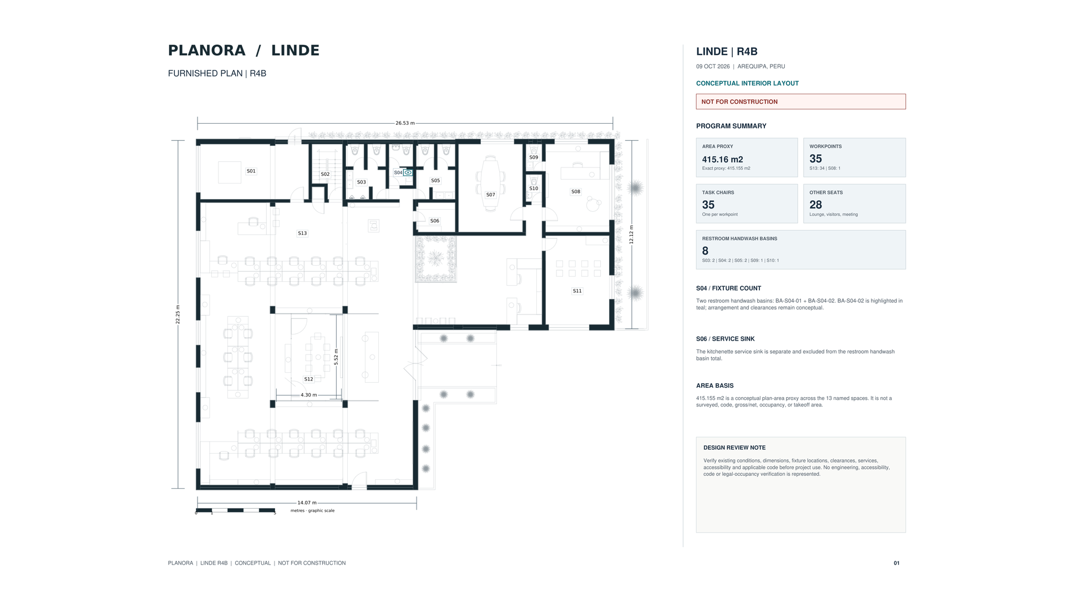
Approved plan
The accepted R4B schematic plan. See the full-size three-page plan PDF and the architecture file guide in the Architecture section of the package.
LINDE · DECISION REVIEW · 9 OCT 2026 · NOT FOR CONSTRUCTION

Slide 5
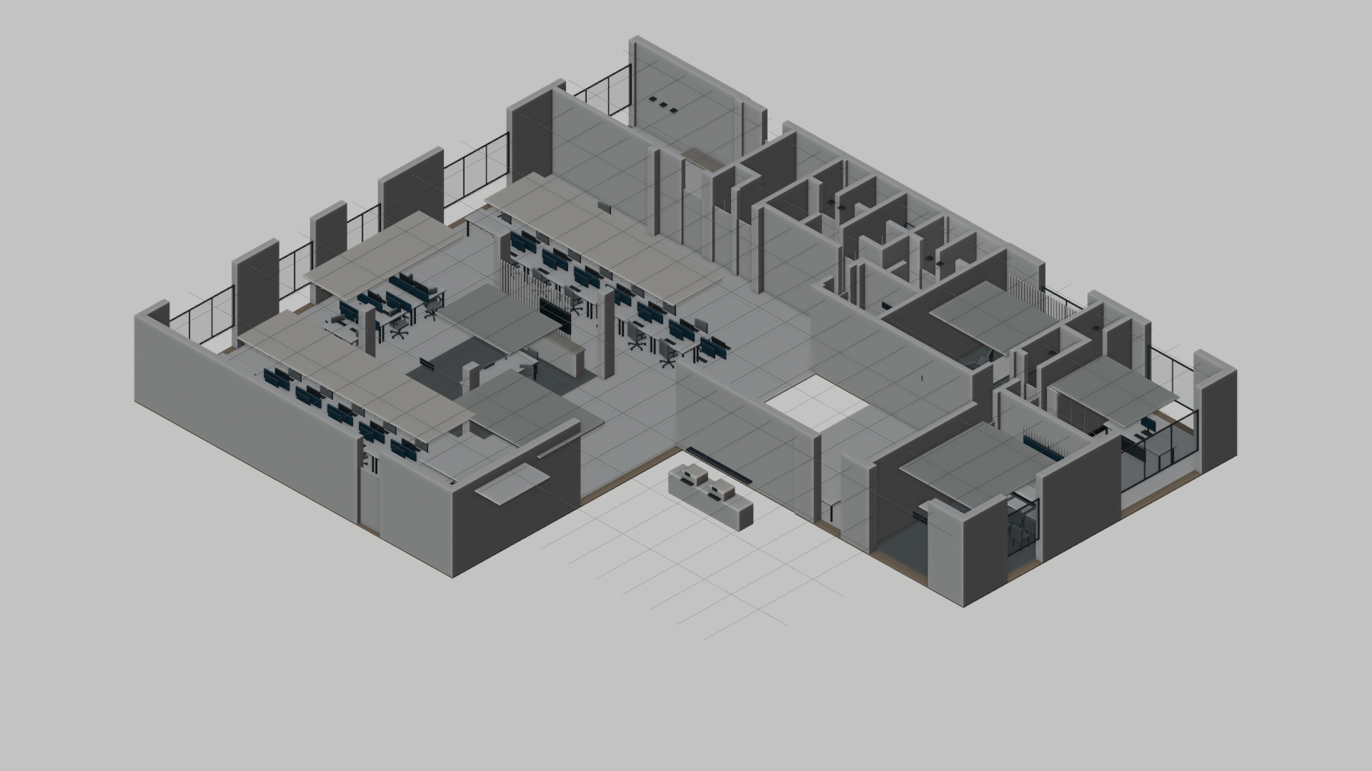
Axonometric view
The accepted axonometric presents the same R4B proposal as the plan. Five separate DWG, BLEND, GLB, IFC and RVT geometric base references do not show the current furnished interior.
LINDE · DECISION REVIEW · 9 OCT 2026 · NOT FOR CONSTRUCTION

Slide 6
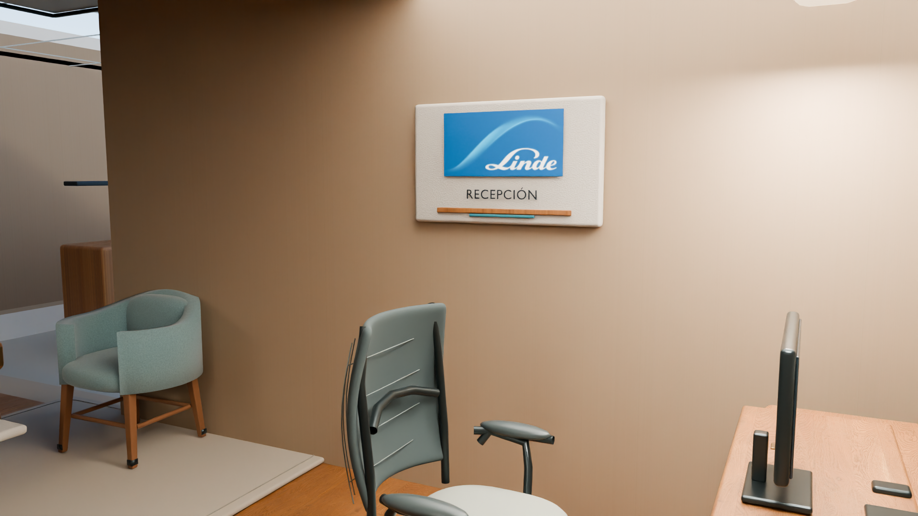
Arrival and reception
The reception identity panel marks the welcome point beside the shared work area. The still retains its modeled Spanish spelling.
The existing still retains the modeled Spanish spelling on the identity panel.
LINDE · DECISION REVIEW · 9 OCT 2026 · NOT FOR CONSTRUCTION

Slide 7
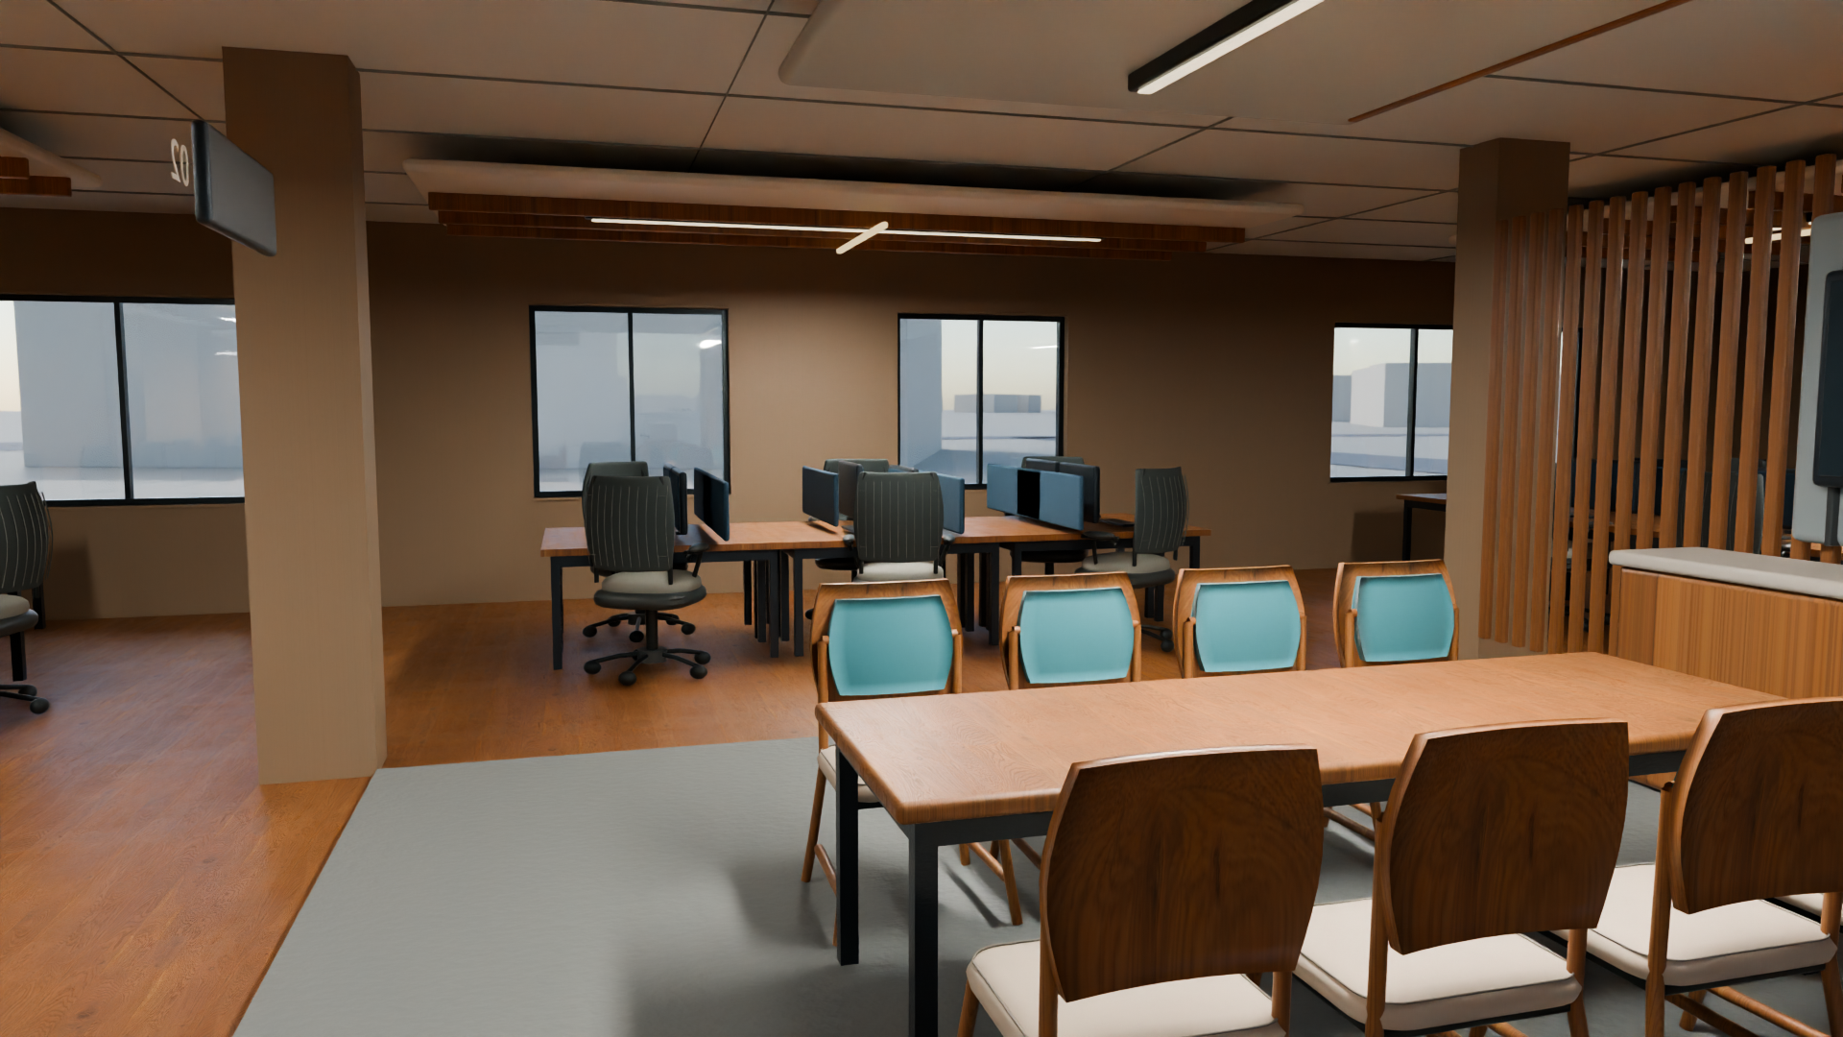
Open workplace
Workpoints sit beside a shared collaboration table. The view communicates character and relationships; it does not establish occupancy or measured fit.
Workpoints and a shared table communicate design intent, not occupancy or measured fit.
LINDE · DECISION REVIEW · 9 OCT 2026 · NOT FOR CONSTRUCTION

Slide 8
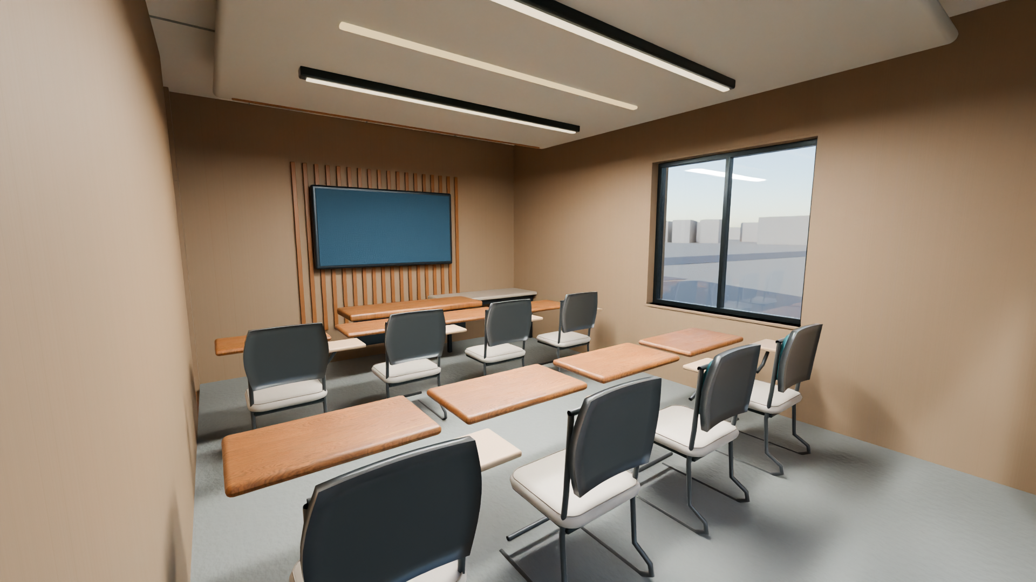
Training room
Group tables face a presentation wall. Seating is furniture intent, not a certified capacity or accessible-clearance determination.
Furniture arrangement is conceptual; capacity and accessible clearances are not certified.
LINDE · DECISION REVIEW · 9 OCT 2026 · NOT FOR CONSTRUCTION

Slide 9
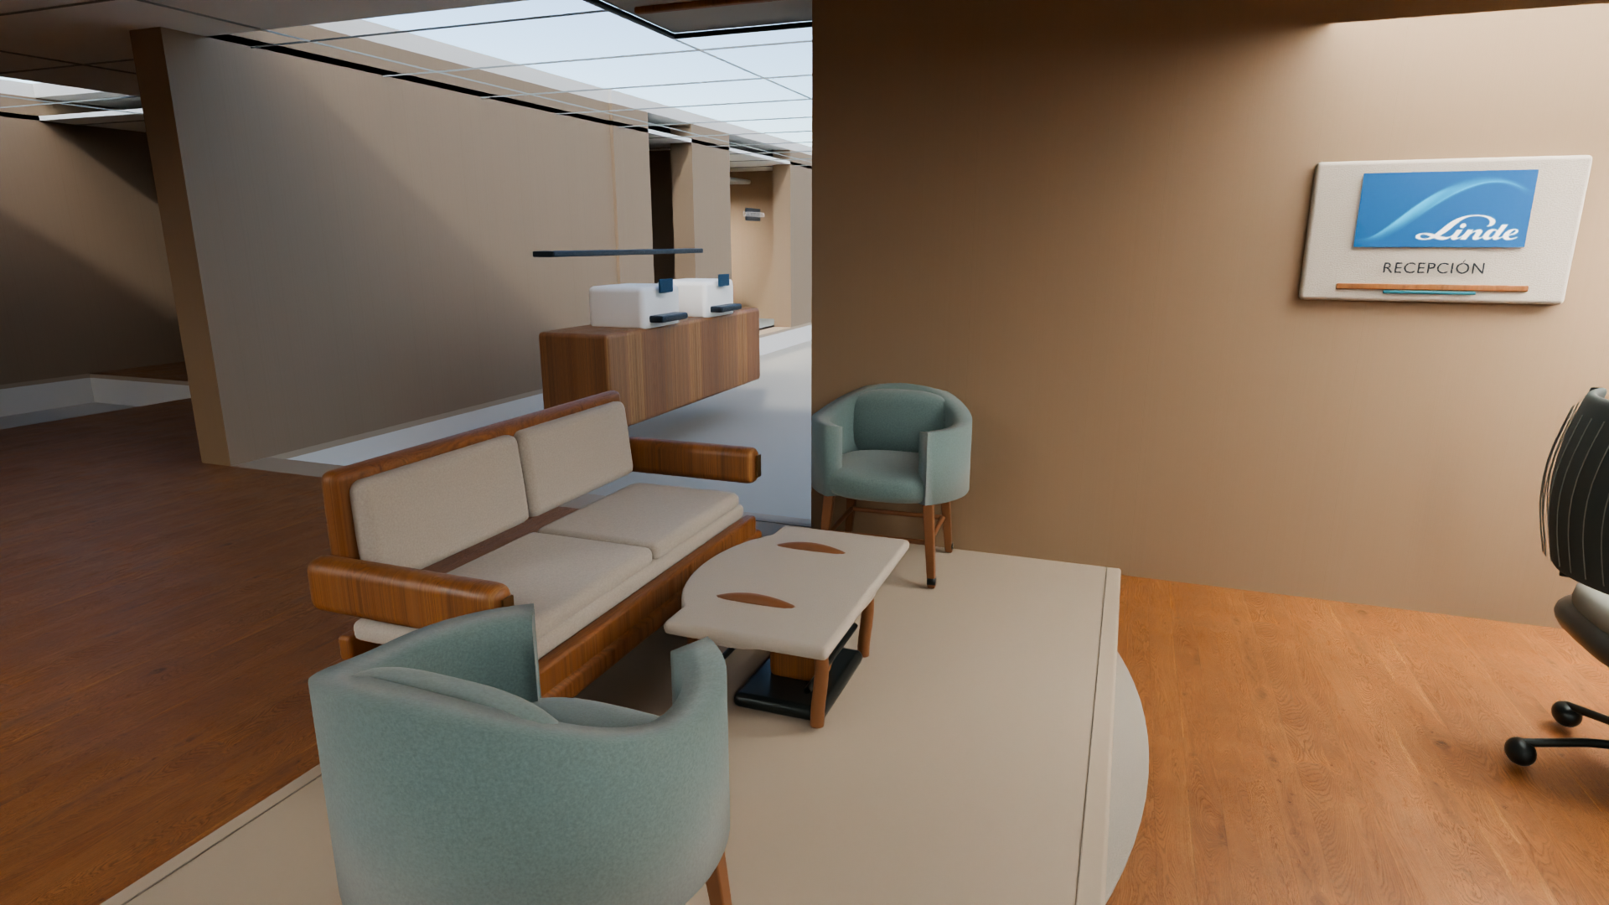
Shared lounge
Soft seating and a timber screen create a shared waiting and pause setting. Furniture and clearances remain conceptual.
Finish and furniture cues are visual direction, not product selections.
LINDE · DECISION REVIEW · 9 OCT 2026 · NOT FOR CONSTRUCTION

Slide 10
MEP interfaces remain open
Electrical and Data: D4.2 remains unchanged. The R4B addendum establishes no R4B-specific Electrical and Data quantity delta; no zero delta is declared. Point reconciliation, circuits, loads, routes, AC-01, luminaire interfaces and data endpoints remain unverified.
Mechanical and HVAC: D4.2 remains unchanged. The R4B additive review updates selected architectural coordination evidence but closes no HVAC design decision. M01–M12 remain open technical scope items for any later design or construction work; their status limits technical claims but does not prevent review of this schematic concept. Its D3.5 sanitary reference is historical; Sanitary D3.6 is the current note.
LINDE · DECISION REVIEW · 9 OCT 2026 · NOT FOR CONSTRUCTION

Slide 11
Restroom interface and R4B
Sanitary D3.6 proposes moving one retained basin station from the S13/open-office area to S04. The room schedule lists eight restroom basins versus seven in the earlier concept; the change is a reassignment, not an added purchase. Separately, the accepted cost addendum reconciles the estimate to six new basins plus two existing S04 basins retained and rehosted. The S06 kitchenette service sink is separate. Services, support, usable clearances and field conditions remain to be verified.
LINDE · DECISION REVIEW · 9 OCT 2026 · NOT FOR CONSTRUCTION

Slide 12
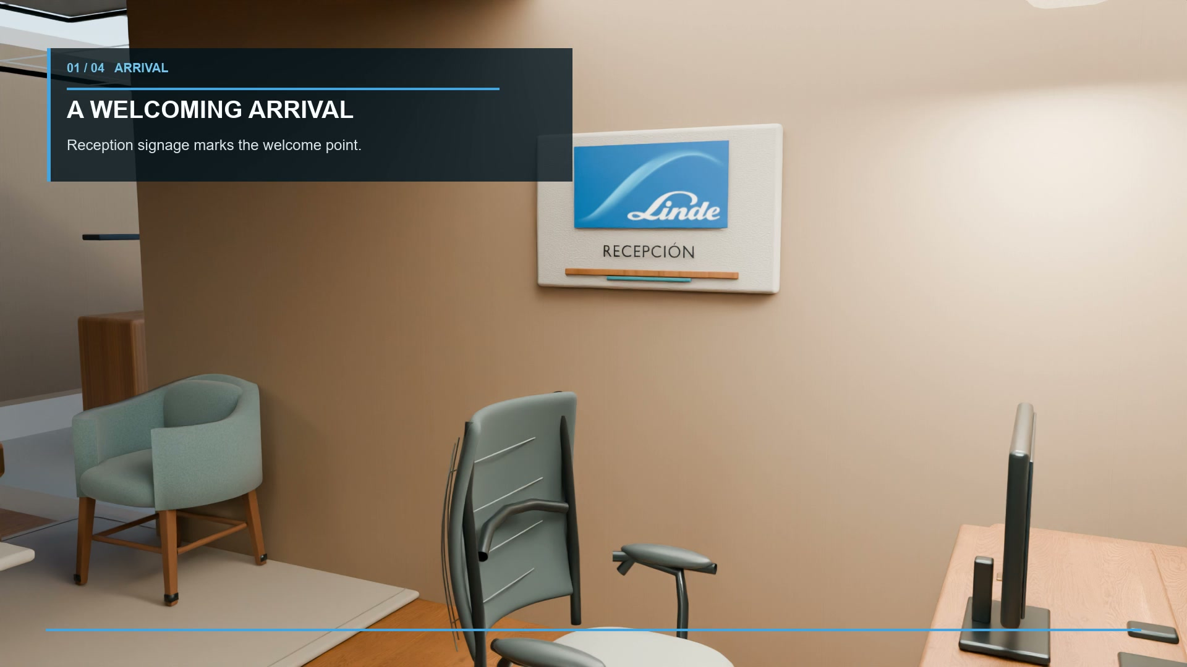
Film and interactive web model
The 44-second film uses editorial motion over four stills; it is not a continuous 3D walkthrough.
The separate interactive R4B web model supports conceptual visual coordination only.
LINDE · DECISION REVIEW · 9 OCT 2026 · NOT FOR CONSTRUCTION

Slide 13
Package and next decision
Decision report · editable and PDF
Decision presentation · editable and PDF
Review guide · editable and PDF
Current technical notes and R4B addenda
R08 cost workbooks, estimate basis + coverage addendum
R09 schedule PDF/XML/basis
R4B web GLB + supplied handoff
Four stills + 44-second film
Decision for review: proceed to measured validation and scope closure before procurement?
LINDE · DECISION REVIEW · 9 OCT 2026 · NOT FOR CONSTRUCTION

Slide 14
Decision premise
This package describes one schematic interior refresh, not alternative designs.
The decision at this stage is whether to commission measured validation and close open scope. The base and sensitivity are conceptual allowances, not an all-in construction budget.
LINDE · DECISION REVIEW · 9 OCT 2026 · NOT FOR CONSTRUCTION

Slide 15
Fit and quantity basis
Area proxies: 415.155 m² architectural schedule · 415.157 m² R08 estimate (0.002 m² displayed difference)
Workpoints / task chairs: 35 represented · 34 new S13 chairs + 1 S08 chair reused subject to field check
Data: 34 new Cat6A drops + 1 existing S08 connection assumed, subject to field check
S08 desk: new supply in existing two-desk allowance; visitor chairs are separate
Other seating: 28 seats in existing allowances
69 assemblies · 146 resources · 64 panels · 30 m cold-water route · 18 m drainage route
All are estimate assumptions, not measured procurement quantities or certified capacity.
LINDE · DECISION REVIEW · 9 OCT 2026 · NOT FOR CONSTRUCTION

Slide 16
Investment scenarios
REPORTED BASE
USD 75,304.53
SAME-DESIGN SENSITIVITY
USD 55,869.25–107,520.39
Same-design sensitivity varies provisional quantities, supplier comparators, productivity and reserve assumptions. It is not a probability interval and does not represent alternative designs.
LINDE · DECISION REVIEW · 9 OCT 2026 · NOT FOR CONSTRUCTION

Slide 17
Cost composition and exclusions
BASE COMPOSITION
NOT INCLUDED
Priced direct scope · USD 61,669.85
Contractor OHP on eligible installation work · USD 3,977.82
Labor / contractor-fee IGV allowance · USD 1,588.51
Owner design-development reserve · USD 8,068.34
Two freight allowances totaling USD 1,048.03 are already in the base.
• Licensed off-site disposal fees
• Major slab/structural or beyond-allowance reconstruction
• New panels/feeders/capacity; life-safety modifications
• Core network, AV, access control; full glazing/door replacement
• Existing-condition/MEP surveys; professional coordination/certification
• Timber refurbishment (incl. R09 UID 76)
• Decorative linear/wall-wash fixtures without measured schedule
• Taxes on unpriced packages; relocation/storage, temporary office, finance, acceleration
Displayed components total USD 75,304.52; the reported base of USD 75,304.53 uses unrounded inputs (USD 0.01 rounding). Excluded items are unpriced, not zero-cost.
LINDE · DECISION REVIEW · 9 OCT 2026 · NOT FOR CONSTRUCTION

Slide 18
Program and dependencies
R09 illustrative window
05 Oct 2026 start → 19 Mar 2027 finish
960 schedule-duration hours = 120 assumed 8-hour days
Estimate basis: 798.38 budget person-hours
The two hour figures describe different things. Neither establishes crews, resource capacity or contractual duration.
R09 stays unchanged. It has no crews/resources, actual progress or resource leveling.
Two consolidated freight allowances are in the cost base; no separate time-based premium is supported.
Dates and supply targets remain planning assumptions, not confirmed supplier promises.
LINDE · DECISION REVIEW · 9 OCT 2026 · NOT FOR CONSTRUCTION

Slide 19
Decision summary
Before procurement: measure areas and existing conditions; verify MEP capacity/routes; resolve the S04 basin interface; obtain licensed disposal pricing; confirm supplier availability and selections; reconcile taxable contract scope.
Only then decide whether to seek a contractor quotation and an approved construction baseline.
Not for construction. No permit/seal. Schematic only.
LINDE · DECISION REVIEW · 9 OCT 2026 · NOT FOR CONSTRUCTION

